Slide 1



Slide 2


Acknowledgement
I would like to express my sincere gratitude to the following individuals and organizations for their support throughout the TumorTrace project:
Infosys Springboard 5.0: For providing the platform, resources, and opportunities to work on this project.
My Mentor, Anurag Sista: For his invaluable guidance, insights, and continuous support, which were instrumental in the successful completion of this project.
Thank you all for your encouragement and contribution to the success of this project.

Slide 3

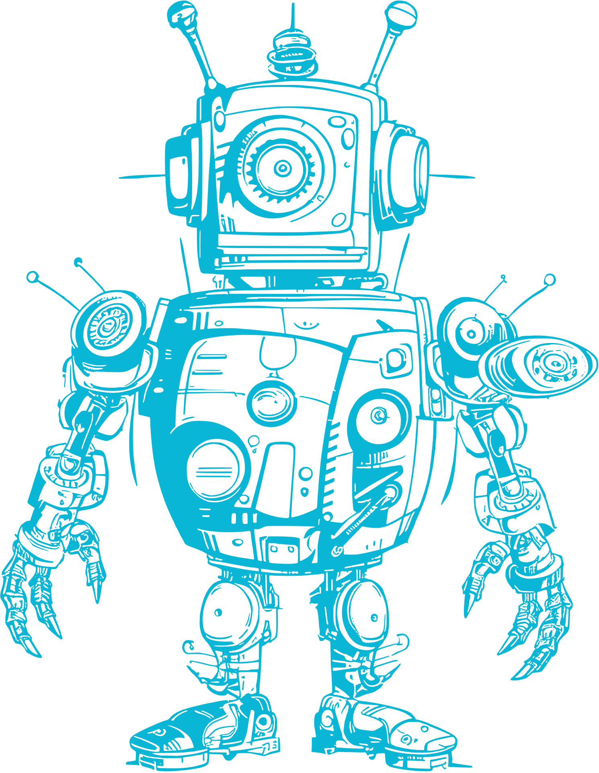

Project
Overview
02
TumorTrace is an AI-based system that uses deep learning models like ResNet and VGG16 to classify breast tumors as benign or malignant from MRI images. It automates tumor detection, improving diagnostic speed and accuracy for healthcare professionals.
Problem Statement :
Breast cancer detection relies heavily on accurate and timely classification of tumors as benign or malignant. However, manual analysis of MRI images is slow, error-prone, and can delay crucial treatment decisions. There is an urgent need for an AI-powered solution that automates and accelerates tumor classification, improving diagnostic accuracy, efficiency, and ultimately, patient outcomes.

Slide 4




03
Methodology
Data Collection and Preprocessing
Model Selection and Training
Model Evaluation and Optimization
MRI images are collected, resized, normalized, and augmented to improve model performance and generalization.
Pre-trained ResNet and VGG16 models are fine-tuned on the dataset
The model is evaluated using accuracy, AUC, and ROC curves, with hyperparameter tuning and early stopping to prevent overfitting.

Slide 5

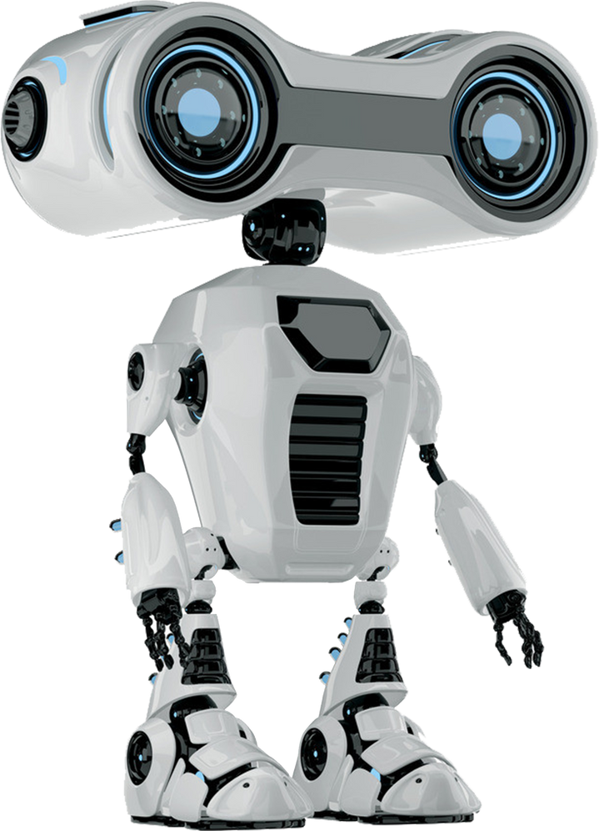
Data Collection and Preprocessing
04
Data Collection
The dataset used in TumorTrace consists of MRI images of breast tumors, labeled as benign or malignant. These images are sourced from publicly available medical image repositories and contain a variety of tumor types, ensuring diversity and comprehensiveness.
Total Number of Images:
Train Set: 20,434 images
Validation Set: 1,989 images
Test Set: 6,851 images
Labels: Benign , Malignant
Data Preprocessing
Resizing: MRI images are resized to a consistent dimension (224x224 pixels).
Normalization: Pixel values are normalized to the range [0, 1].
Data Augmentation: Techniques like rotation, flipping, and zooming are applied to increase dataset diversity and improve model robustness.

Slide 6

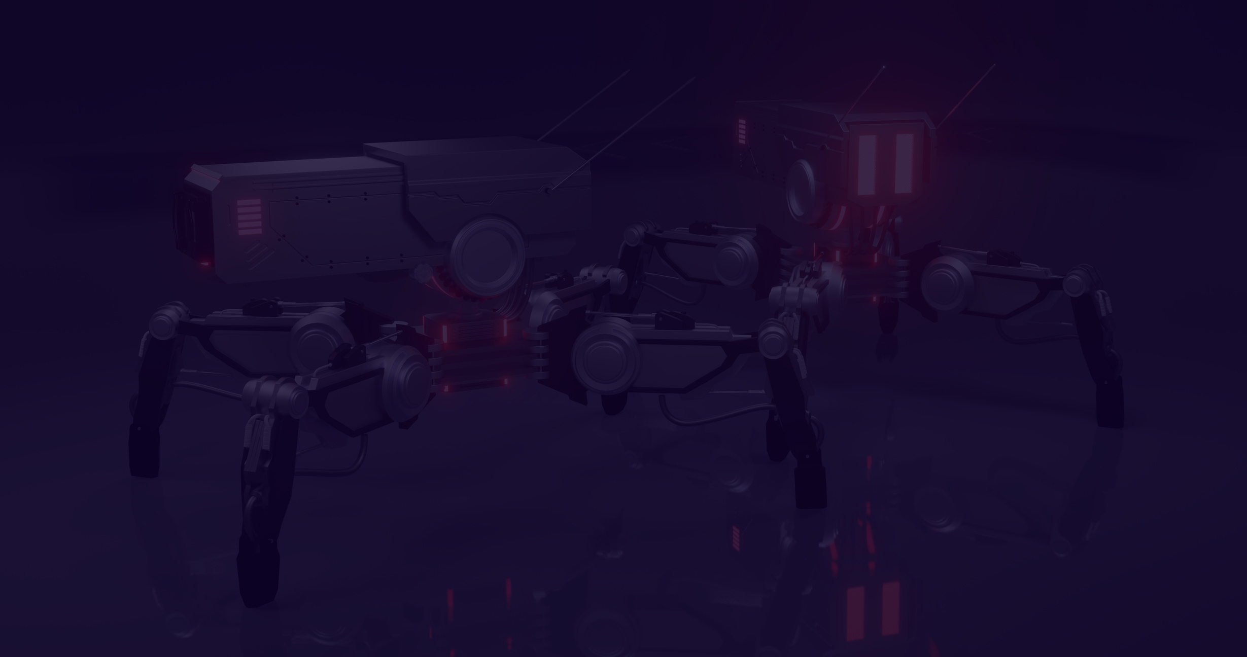

05
FEATURE EXTRACTION TECHNIQUES
HOG: Captures edge and shape information by analyzing gradient patterns, helping identify tumor boundaries.
GLCM: Extracts textural features like contrast, energy, and homogeneity to distinguish between benign and malignant tumors.
Sobel Operator: Detects edges by calculating gradients, highlighting tumor boundaries.
LBP: Captures local texture patterns, useful for distinguishing subtle differences between tumors.
MVM-LBP: Enhances LBP by incorporating mean, variance, and median, providing a more robust texture descriptor for better classification.

Slide 7



06
Models Used
VGG16 : A 16-layer CNN with a simple yet powerful architecture, known for effective feature extraction using small 3x3 filters. It serves as a baseline model for classifying tumors as benign or malignant.
ResNet18 : A lightweight 18-layer residual network that uses skip connections to address vanishing gradients. It provides efficient training and good performance, especially on smaller or less complex datasets.
ResNet50 : A deeper version of ResNet with 50 layers, designed to capture complex and detailed tumor features. Its bottleneck architecture allows for computational efficiency while maintaining high accuracy.

Slide 8
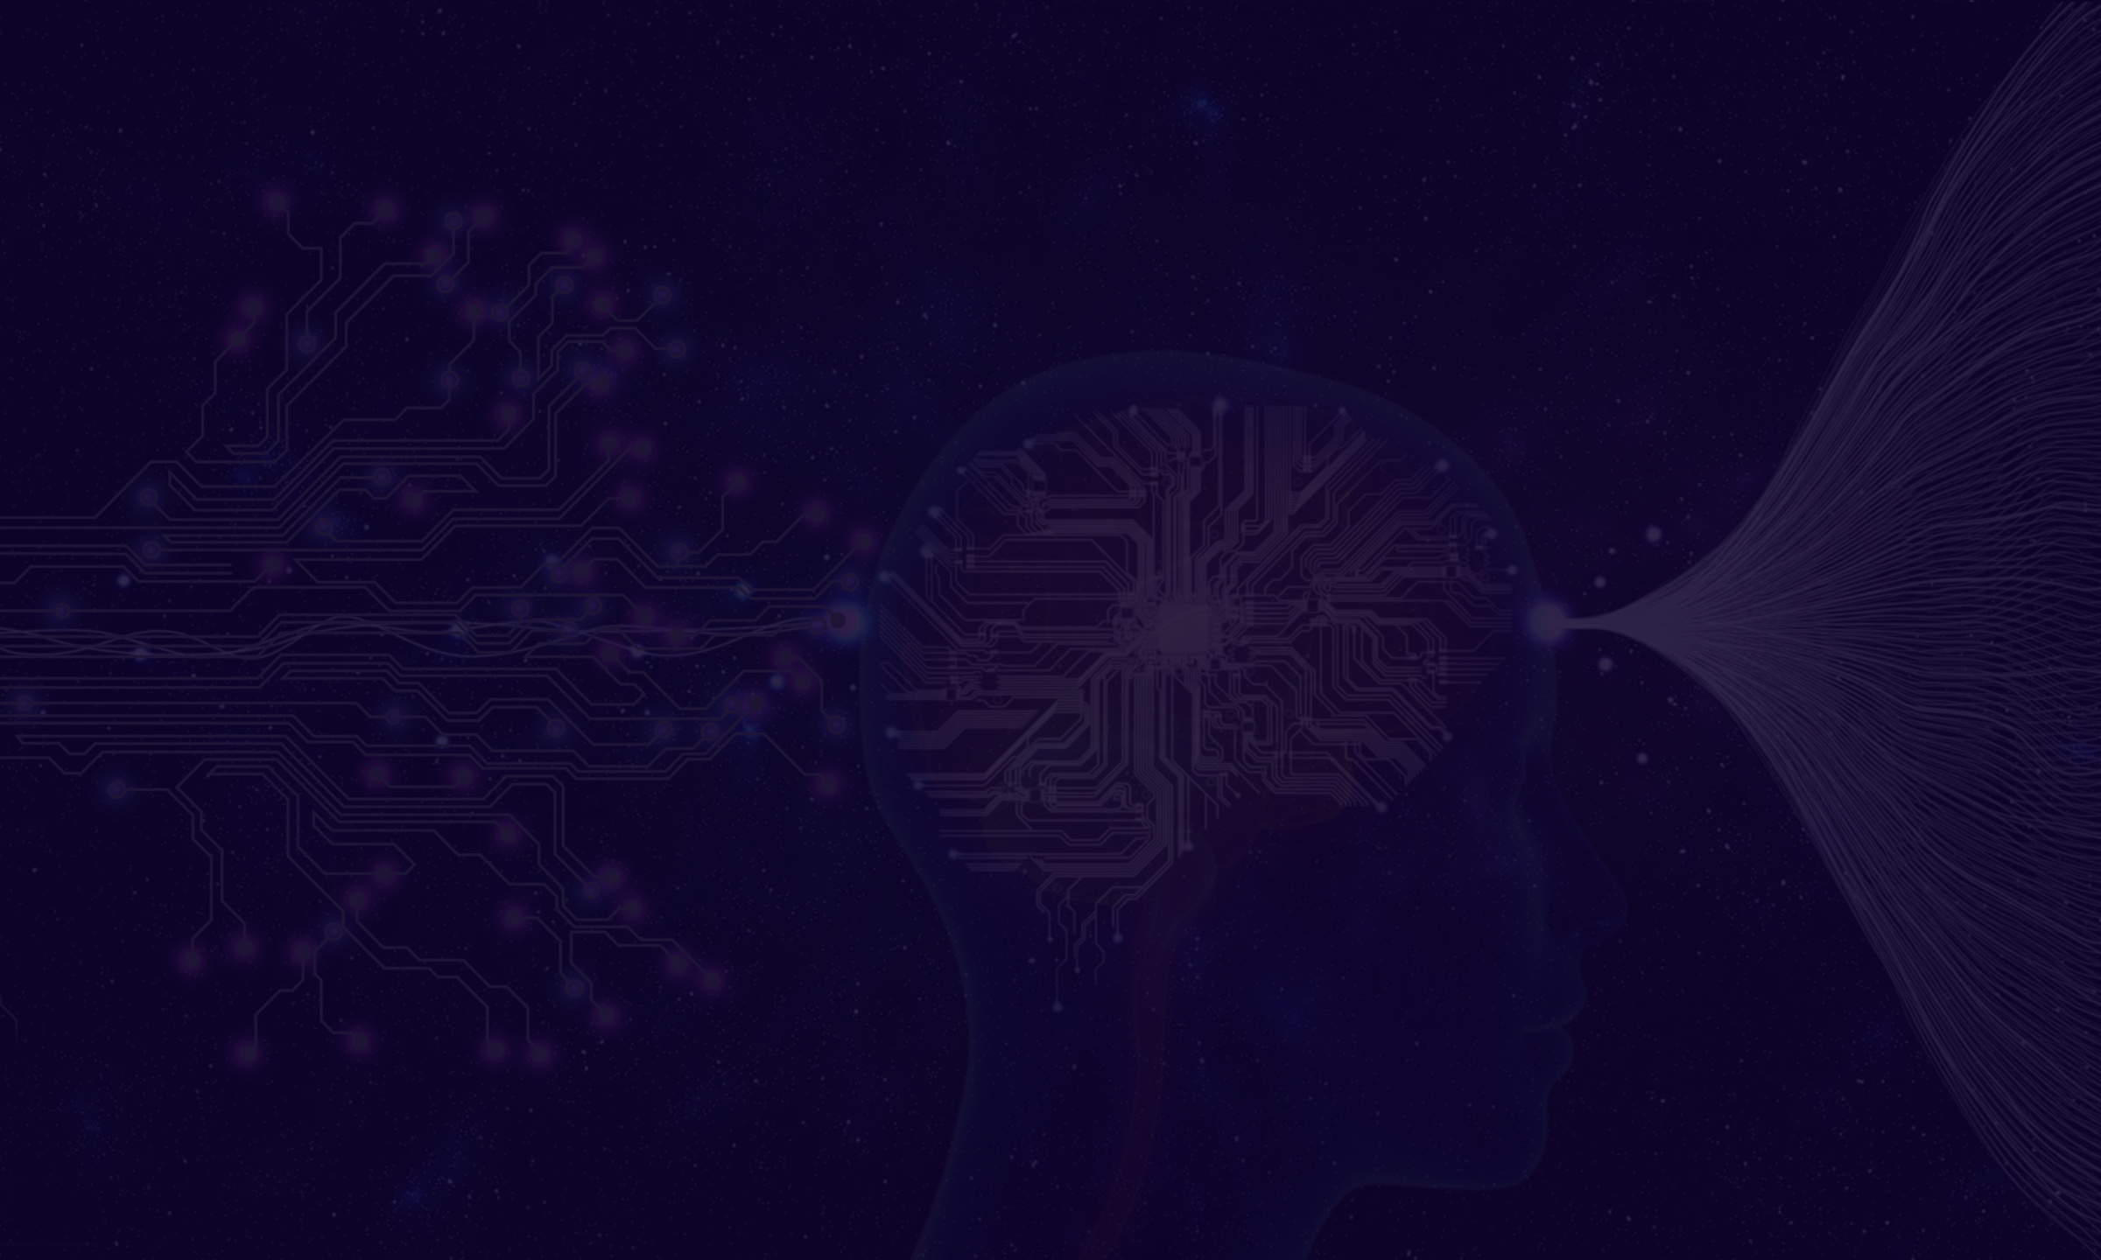
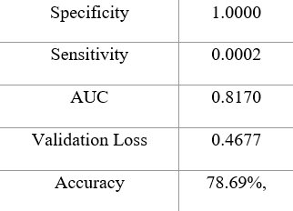
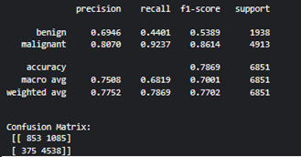

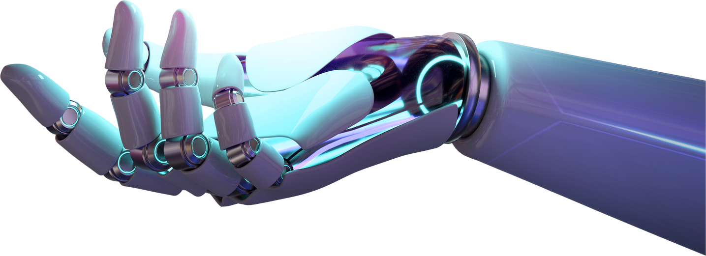
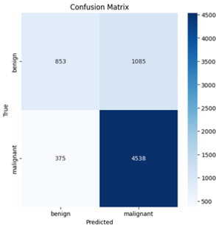
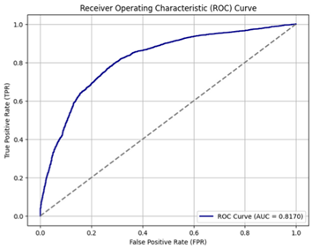
RESULTS
VGG16
07

Slide 9
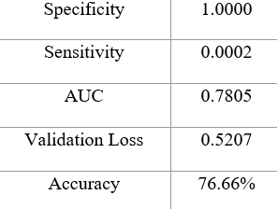
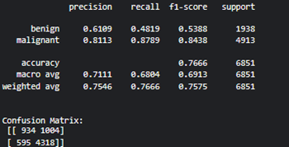

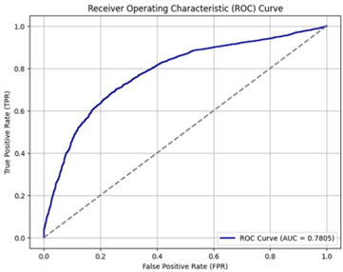
RESULTS
RESNET18
08

Slide 10
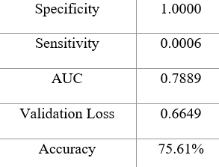
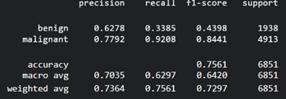
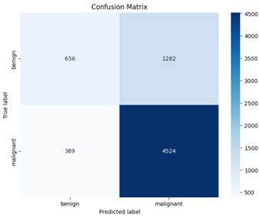
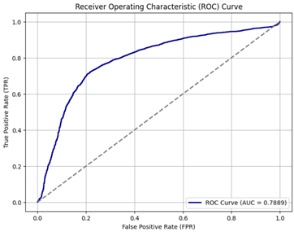
RESULTS
RESNET50
09

Slide 11


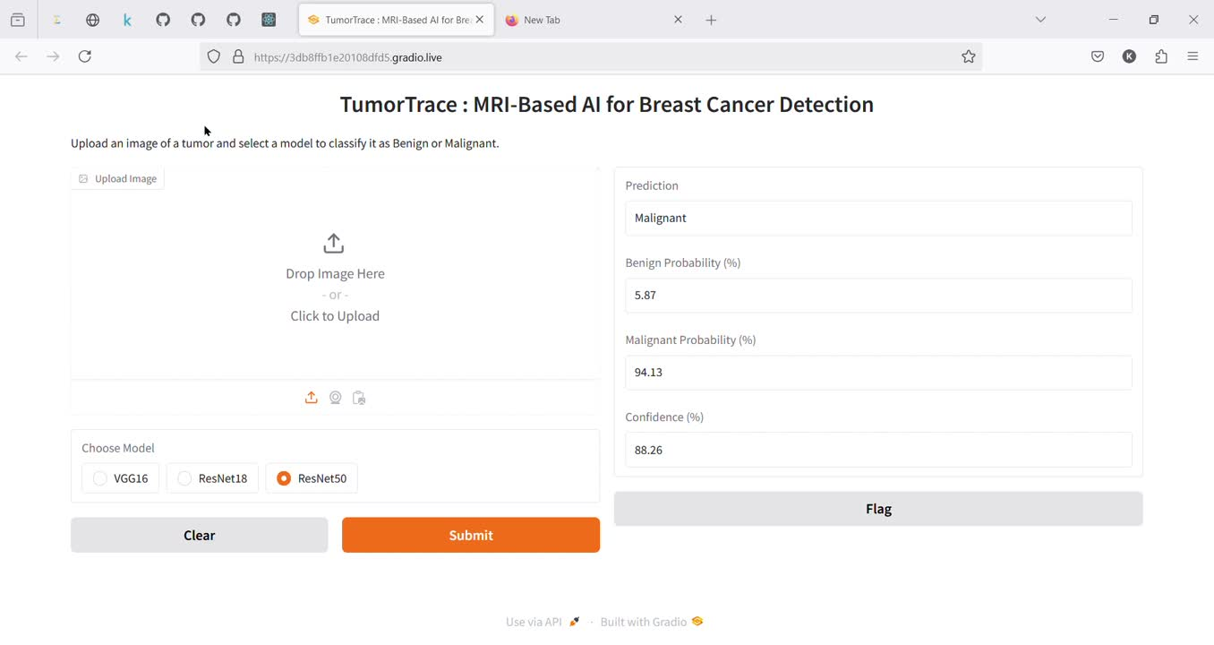
OUTPUT
10

